Slide 1
Four forms of Mater Theorem

Slide 2
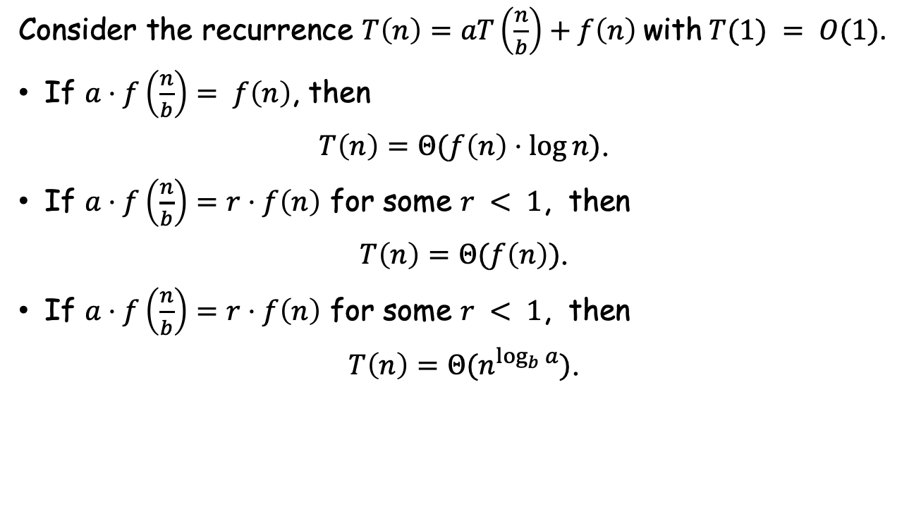
Form 1
Consider the recurrence $T\left(n\right)=aT\left(\frac{n}{b}\right)+f\left(n\right)$ with $T(1) = O(1)$.
If $a⋅f\left(\frac{n}{b}\right)= f\left(n\right)$, then
$T\left(n\right)=Θ(f\left(n\right)⋅\log{n})$.
If $a⋅f\left(\frac{n}{b}\right)=r⋅f\left(n\right)$ for some $r < 1$, then
$T\left(n\right)=Θ(f\left(n\right))$.
If $a⋅f\left(\frac{n}{b}\right)=r⋅f\left(n\right)$ for some $r < 1$, then
$T\left(n\right)=Θ(n^{\log_{b}{a}})$.

Slide 3
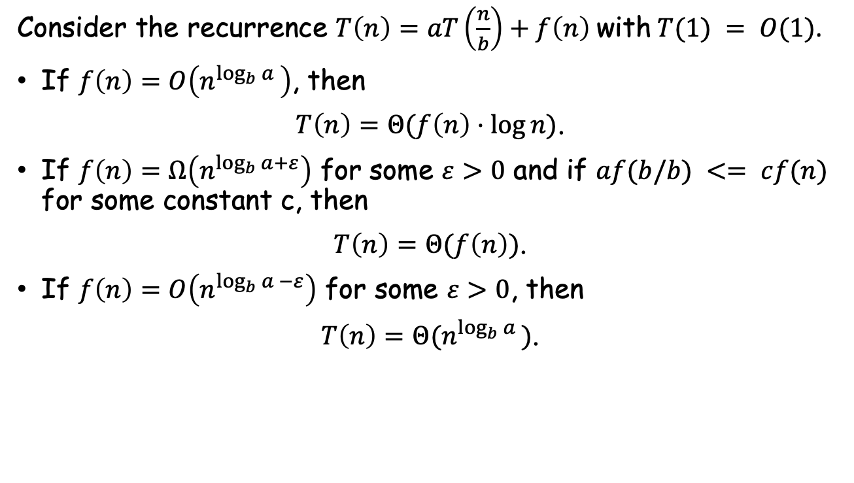
Form 2
Consider the recurrence $T\left(n\right)=aT\left(\frac{n}{b}\right)+f\left(n\right)$ with $T(1) = O(1)$.
If $f\left(n\right)=O\left(n^{\log_{b}{a} }\right)$, then
$T\left(n\right)=Θ(f\left(n\right)⋅\log{n})$.
If $f\left(n\right)=Ω\left(n^{\log_{b}{a}+ε}\right)$ for some $ε>0$ and if $af(b/b) <= cf(n)$ for some constant c, then
$T\left(n\right)=Θ(f\left(n\right))$.
If $f\left(n\right)=O\left(n^{\log_{b}{a} −ε}\right)$ for some $ε>0$, then
$T\left(n\right)=Θ(n^{\log_{b}{a} })$.

Slide 4
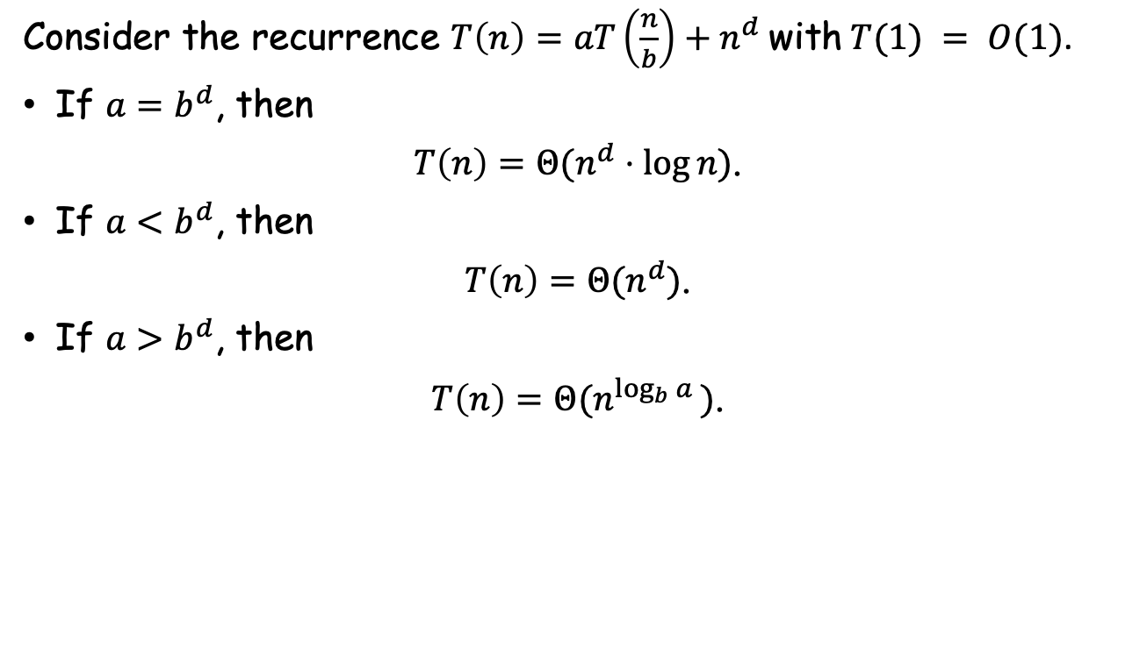
Form 3
Consider the recurrence $T\left(n\right)=aT\left(\frac{n}{b}\right)+n^{d}$ with $T(1) = O(1)$.
If $a=b^{d}$, then
$T\left(n\right)=Θ(n^{d}⋅\log{n})$.
If $a<b^{d}$, then
$T\left(n\right)=Θ(n^{d})$.
If $a>b^{d}$, then
$T\left(n\right)=Θ(n^{\log_{b}{a} })$.

Slide 5
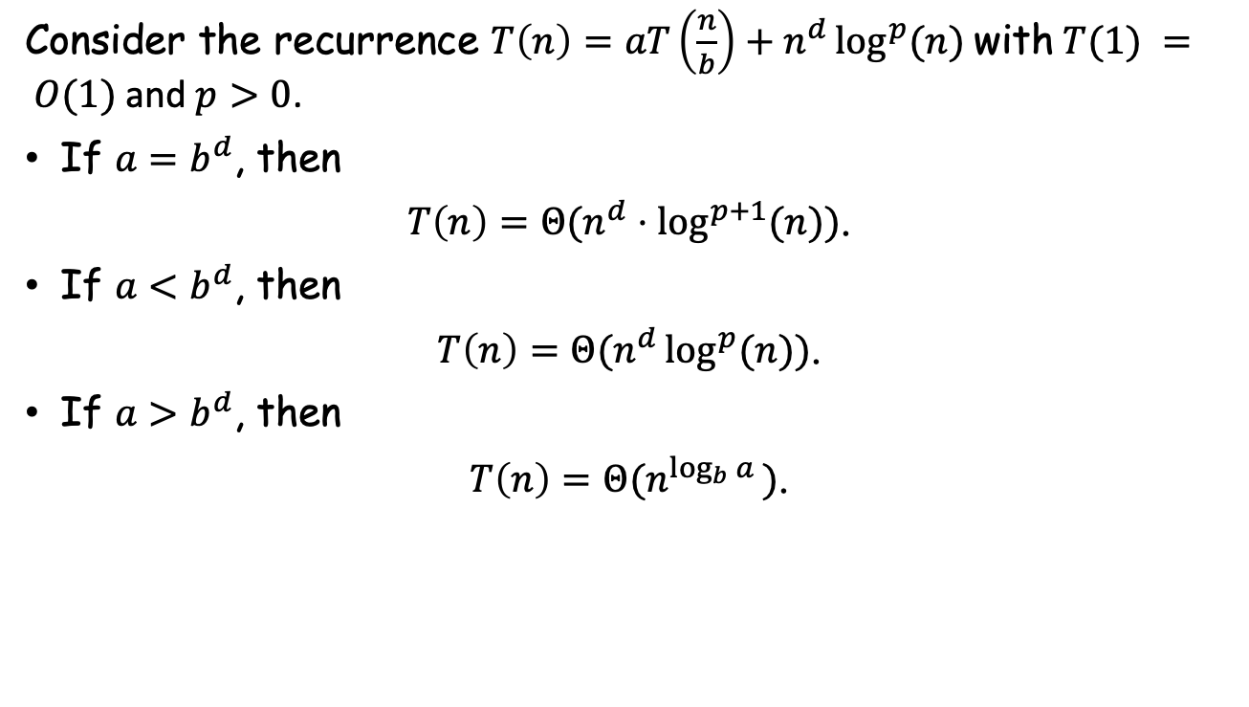
Form 4
Consider the recurrence $T\left(n\right)=aT\left(\frac{n}{b}\right)+n^{d}\log^{p}{(n)}$ with $T(1) = O(1)$ and $p>0$.
If $a=b^{d}$, then
$T\left(n\right)=Θ(n^{d}⋅\log^{p+1}{(n)})$.
If $a<b^{d}$, then
$T\left(n\right)=Θ(n^{d}\log^{p}{(n)})$.
If $a>b^{d}$, then
$T\left(n\right)=Θ(n^{\log_{b}{a} })$.

